Slide 1
Mobile Development with
Web Tech
Lwin Maung Accolade Systems

Slide 2

About Lwin
Developer
Trainer
Co-author of "Developing ASP.NET MVC 4 Web Applications"
Author in Process (Pluralsight)
Speaker / Community Leader

Slide 3

Training

Slide 4
Expectations


I want you to talk to each other and me!

Slide 5
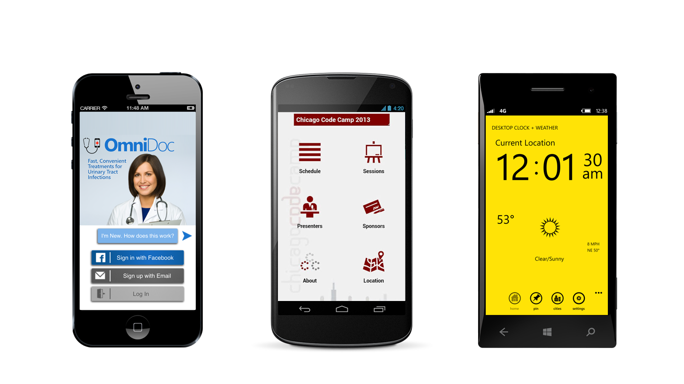
Mobile Developer

Slide 6





Slide 7
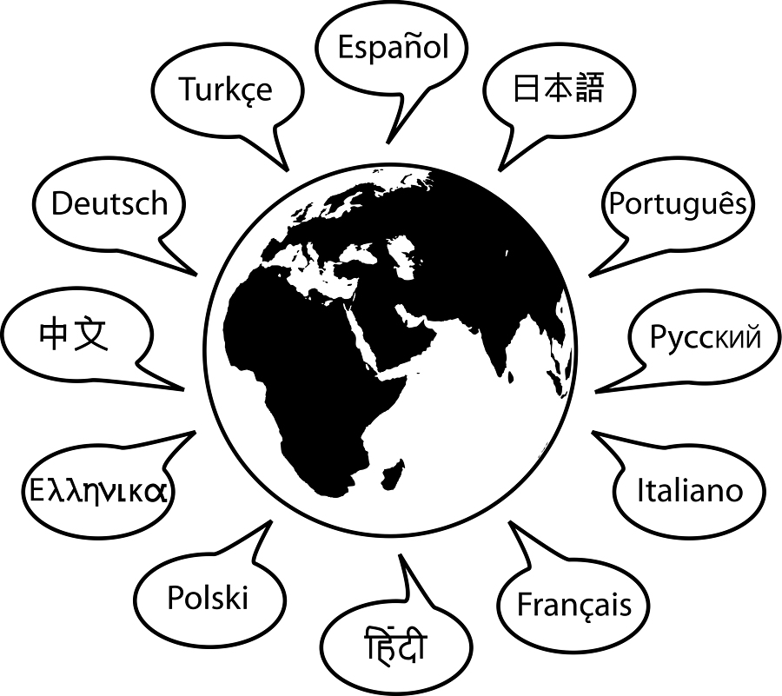
Languages

Slide 8

Languages Understood

Slide 9
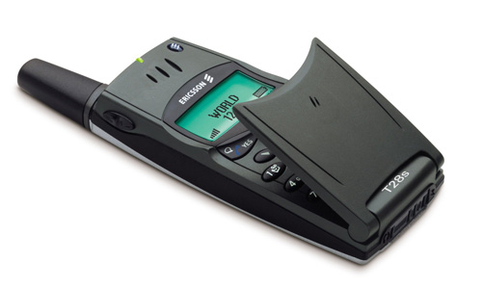
Let’s talk about mobile

Slide 10
Numbers
331,000,000
Number of US Mobile phone subscriptions
August 2012

Slide 11
Numbers
5,980,000,000
Number of Global Mobile phone subscriptions
August 2012

Slide 12
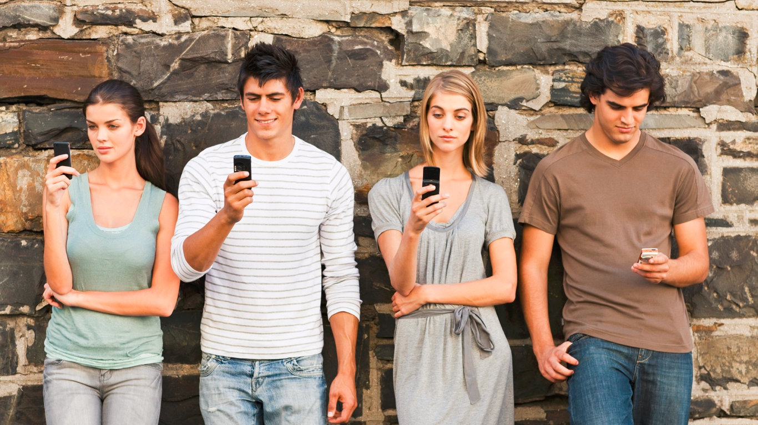
1064 texts per month
35/Day

Slide 13
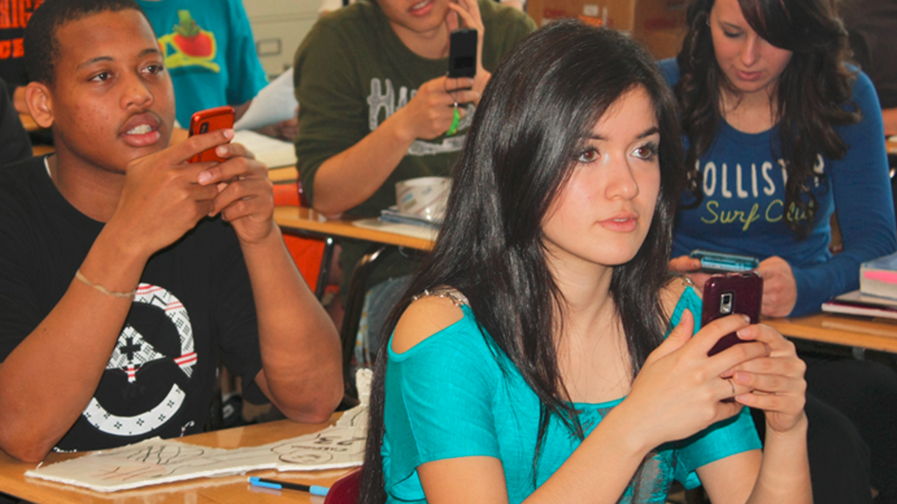

13-19
4050 texts per month

Slide 14
Phones

Slide 15
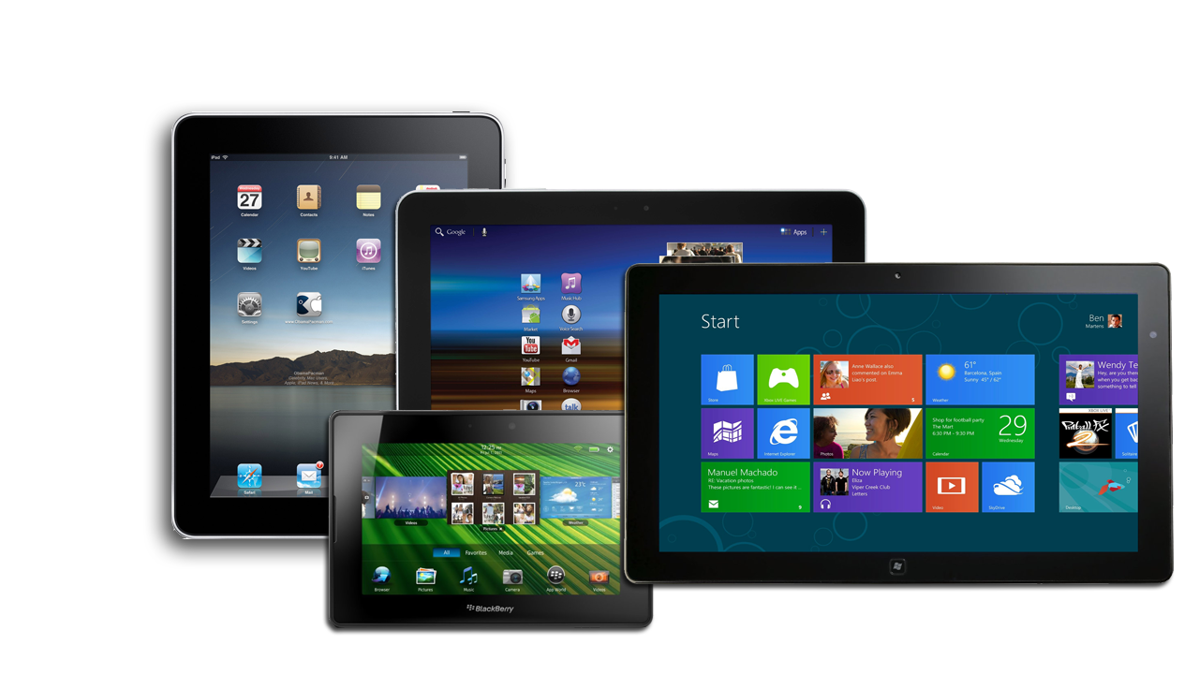
What about tablets?

Slide 16
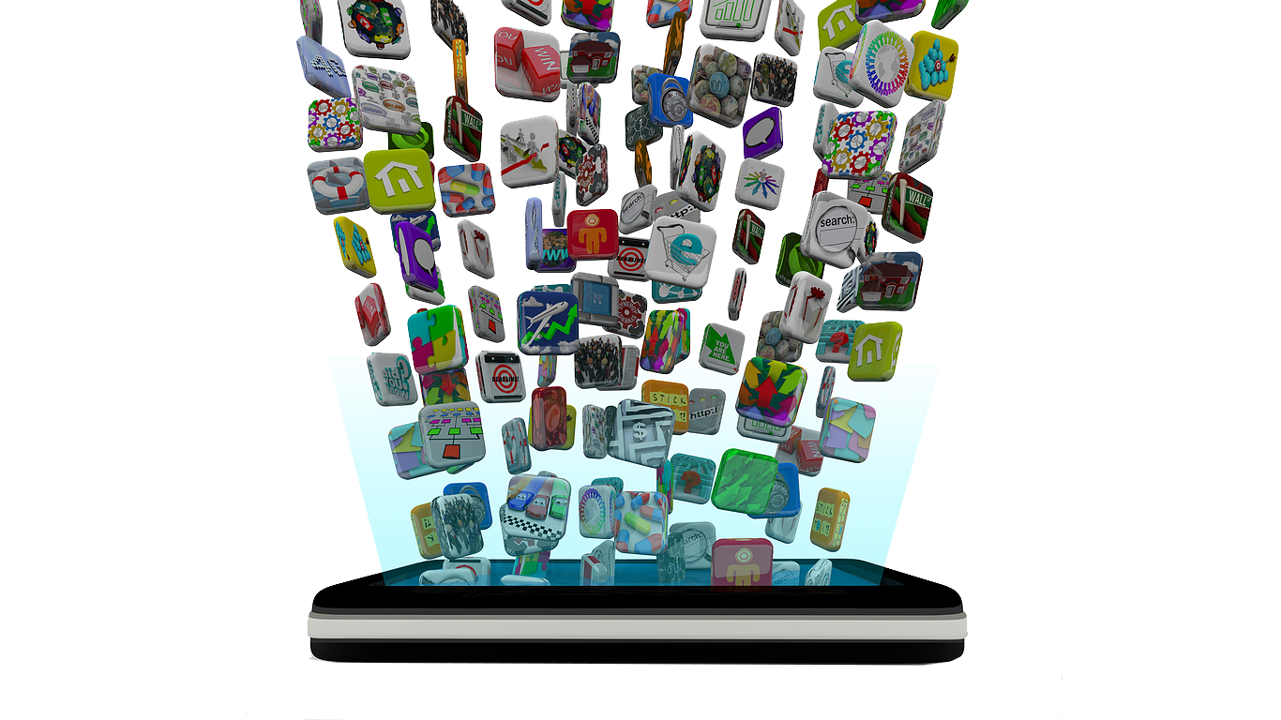
Apps?

Slide 17

Web?

Slide 18
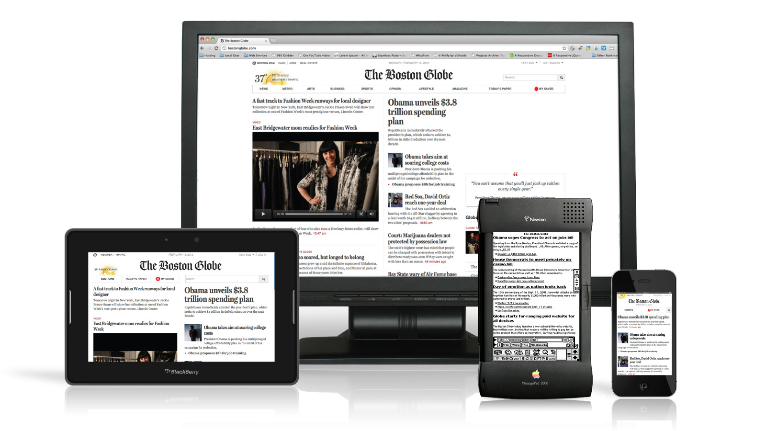
Web + Mobile

Slide 19
Browser HTML5 Story
SEMANTICS
OFFLINE & STORAGE
DEVICE ACCESS
CONNECTIVITY
MULTIMEDIA
3D, GRAPHICS & EFFECTS
PERFORMANCE & INTEGRATION
CSS3

Slide 20





Mobile Apps
bada
webOS

Slide 21



Mobile Apps

Slide 22

Wild West…

Slide 23
Languages
Strong Type
Weak Type
C#
Java VB.NET
Python
Ruby
Strong Ref.
C / C++
CB6
Weak Ref.
JS

Slide 24
Overview
5/25
6/1
6/8
6/15
INTRO
DESIGN / CRAFTMANSHIP
SETUP
HTML / CSS
JAVASCRIPT
JQUERY
INTRO TO PHONEGAP
INTRO TO KENDO
6/22
6/29
7/6
7/13
CONNECTIONS
STORAGE
FILES
MEDIA
CAMERA
CAPTURE
CONTACTS
7/20
7/28
8/3
8/10
GEOLOCATION
COMPASS
ACCELEROMETER
PERSONAL PROJECT
PERSONAL PROJECT
PERSONAL PROJECT

Slide 25
Formula for Success

Slide 26

Feel the beauty

Slide 27

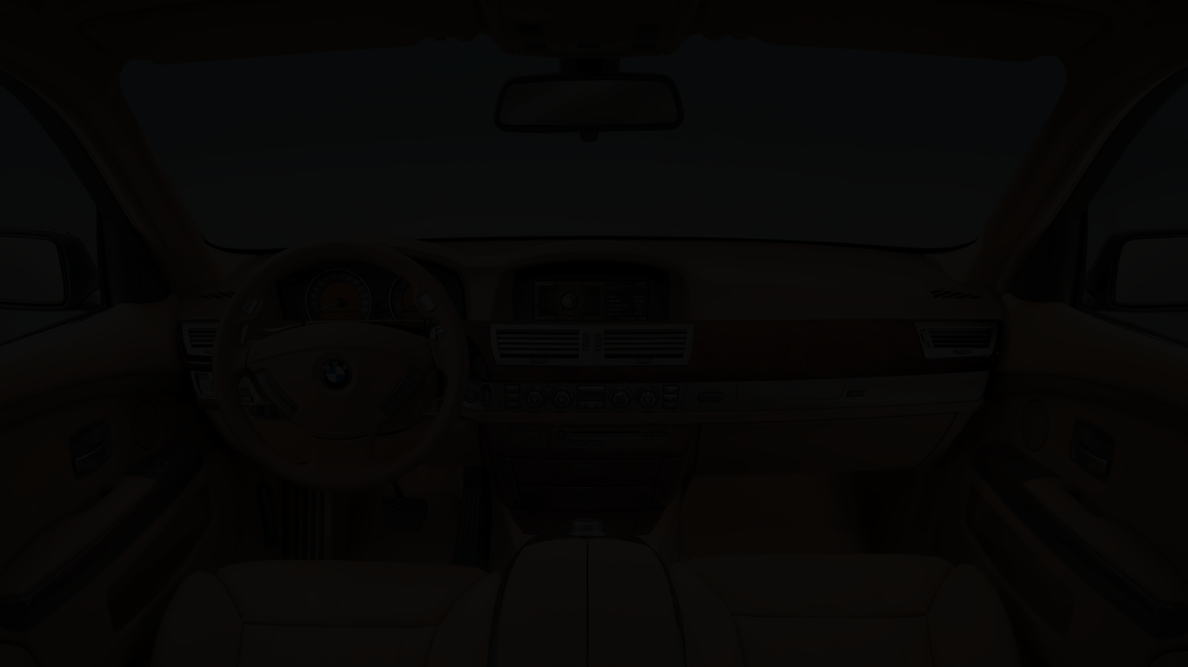

Slide 28
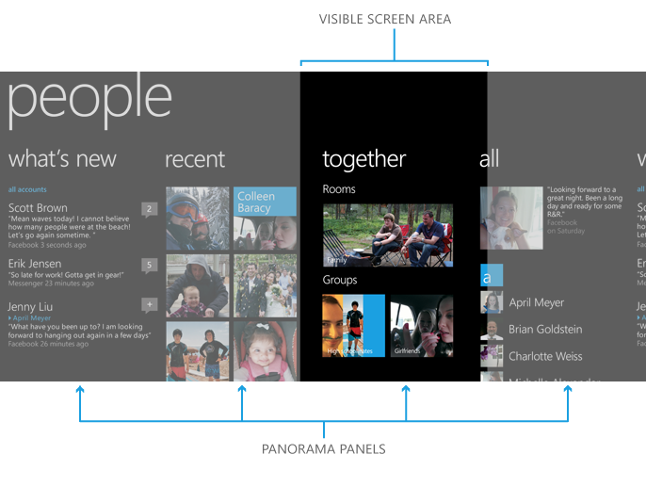
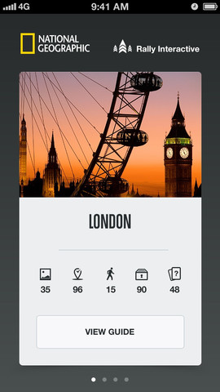
Tiny big things

Slide 29
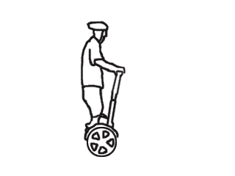
Animations are good?!

Slide 30
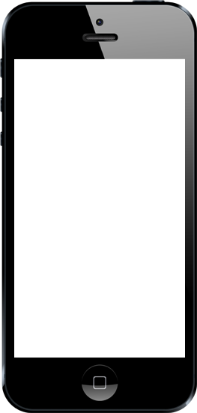
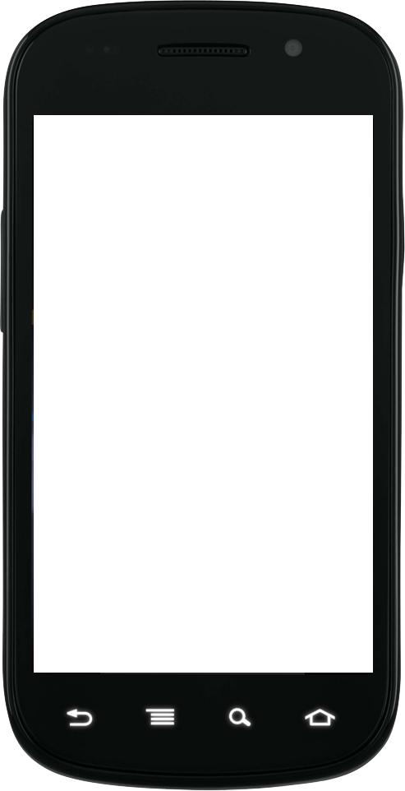
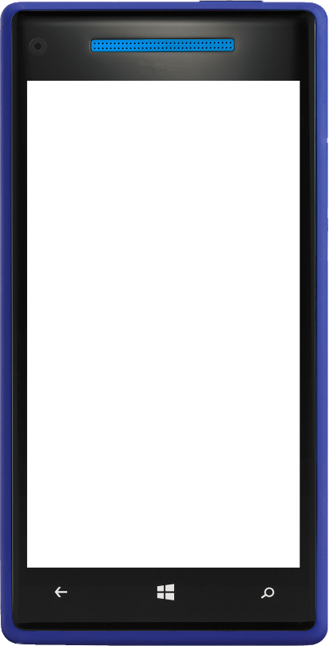
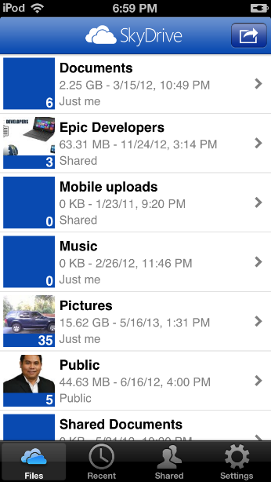
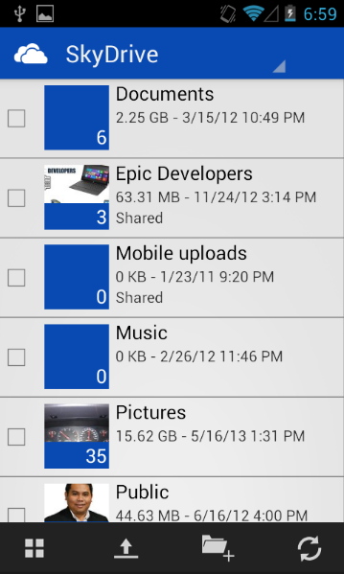
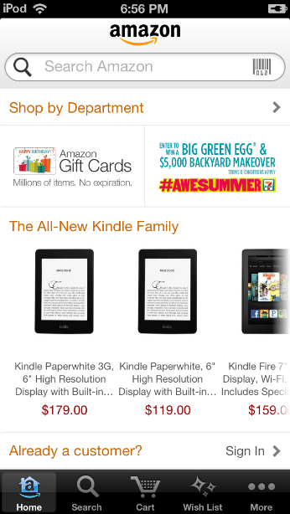
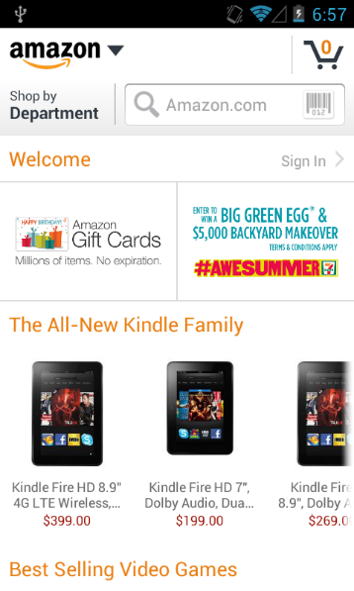
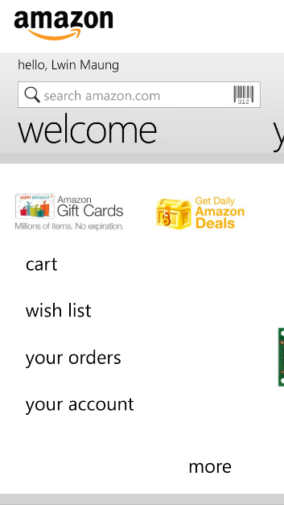
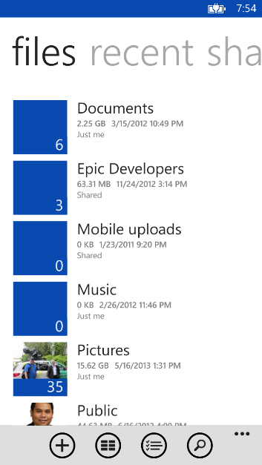
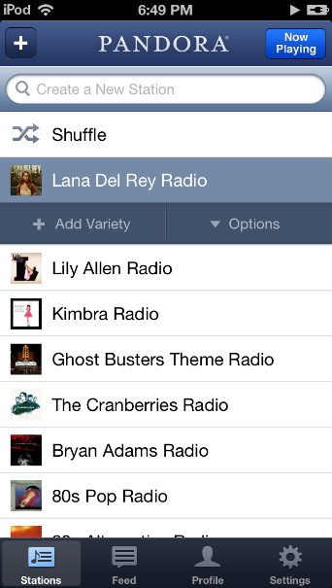
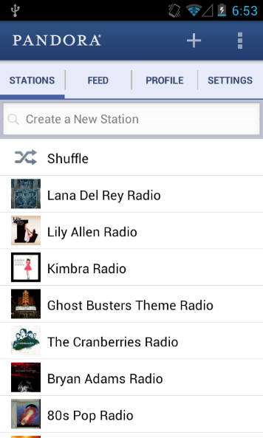
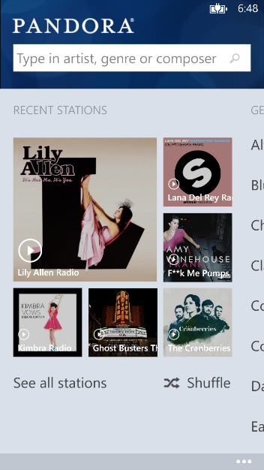
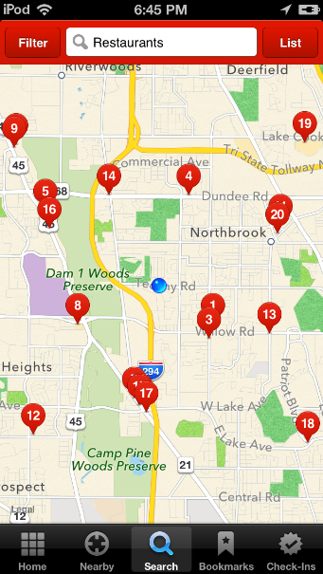
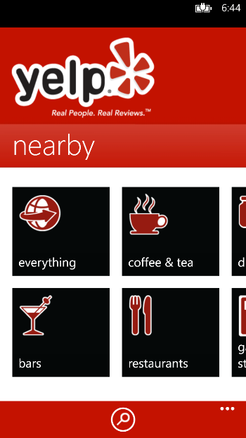
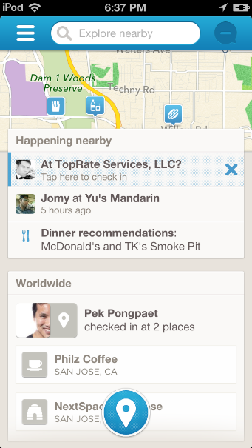
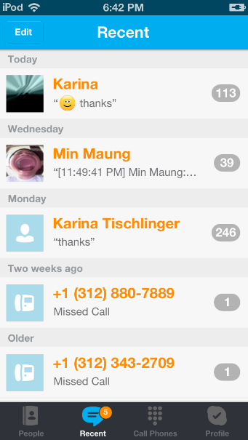
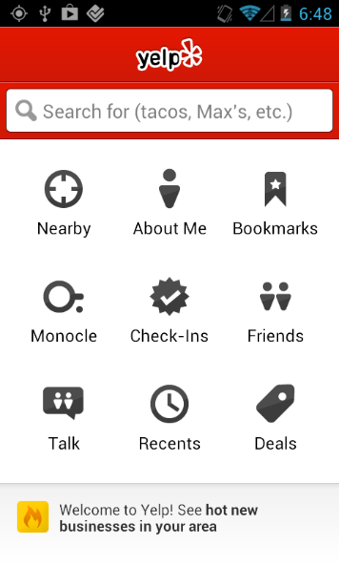
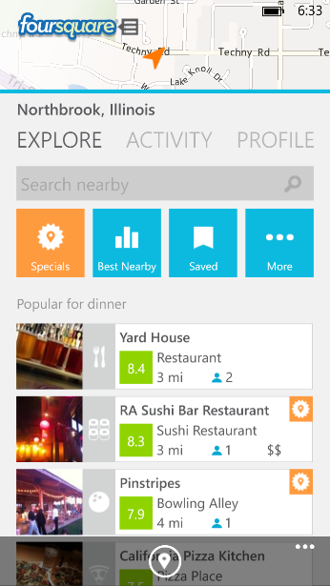
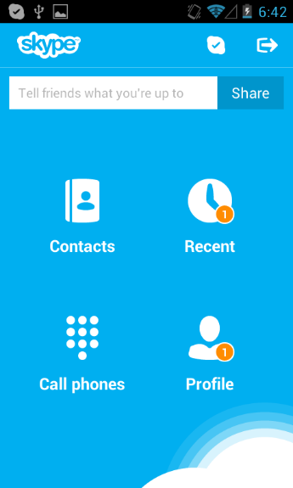
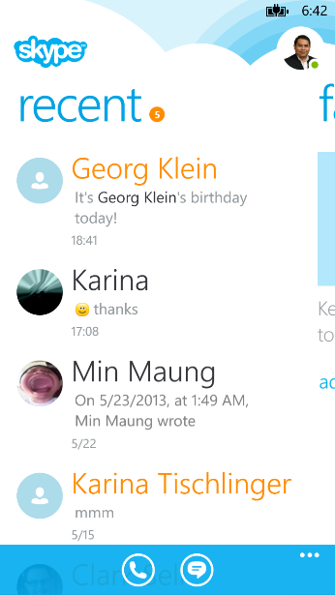
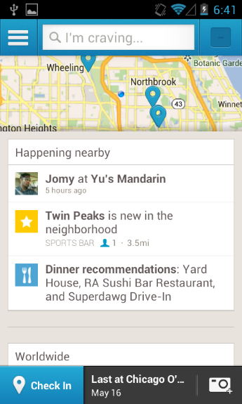
UX matters

Slide 31

UX matters
UNLESS YOU ARE

Slide 32
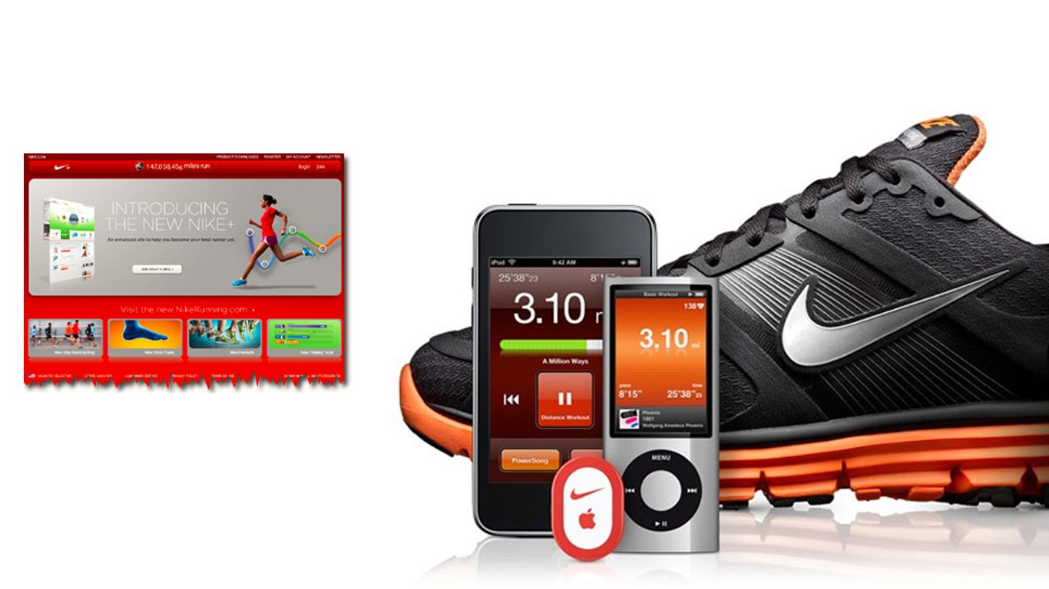
DO

Slide 33
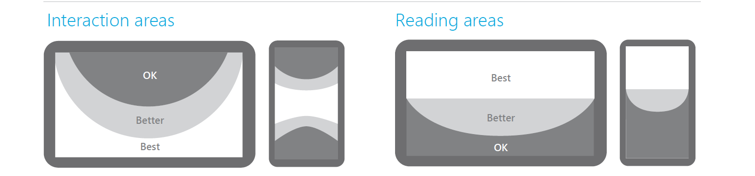
Design for Touch First
Design with hands and fingers in mind
Interaction areas
Reading areas
Notes:
RE: Actions should be reversible so users can safely explore.
Example – swipe to select is reversible

Slide 34

Keep It Simple

Slide 35
Choose the right scenarios
Notes:
10:00

Slide 36
The best “Best at” statement
One sentence
Specific
Truly differentiated
Example: Food With Friends is the best app in its category at helping users and their friends find a restaurant to eat at tonight.
Example: Food With Friends

Slide 37
This app is the best app in its category at __________.

Slide 38
Only pick scenarios that directly support the “Best at” statement

Slide 39
Scenario brainstorming
Food with Friends
Find restaurants that my friends want to eat at
Search for a restaurant
Read a review
Get business details, prices, location, contact info, etc.
Find restaurants that I want to eat at
View, send, or print directions
Interact with restaurant owners
View or share photos of a restaurant
See suggested restaurants
Write a review
Find restaurants that I want to eat at
Find activities to do before and after eating
Return to favorite restaurants
Decide with friends what the right restaurant to go to is
Bookmark restaurants
Create an app account and profile
Set or change location
Share my experiences with friends

Slide 40
Scenario brainstorming
Remove the features
Find restaurants that my friends want to eat at
Search for a restaurant
Read a review
Get business details, prices, location, contact info, etc.
Find restaurants that I want to eat at
View, send, or print directions
Interact with restaurant owners
View or share photos of a restaurant
See suggested restaurants
Write a review
Find restaurants that I want to eat at
Find activities to do before and after eating
Return to favorite restaurants
Decide with friends what the right restaurant to go to is
Bookmark restaurants
Create an app account and profile
Set or change location
Share my experiences with friends

Slide 41
Scenario brainstorming
Remove the scenarios that don’t tie to the “Best at” statement
Find restaurants that my friends want to eat at
Search for a restaurant
Read a review
Get business details, prices, location, contact info, etc.
Find restaurants that I want to eat at
View, send, or print directions
Interact with restaurant owners
View or share photos of a restaurant
See suggested restaurants
Write a review
Find restaurants that I want to eat at
Find activities to do before and after eating
Catalog all the restaurants I’ve been to
Decide with friends what the right restaurant to go to is
Bookmark restaurants
Create an app account and profile
Set or change location
Share my experiences with friends

Slide 42
Example: Food With Friends “Best at” statement: Food With Friends is the best app in its category at helping users and their friends find a restaurant to eat at tonight.
Scenarios that line up with the “Best at” statement
Find restaurants that my friends want to eat at
Find restaurants that I want to eat at
Make dinner plans for tonight with friends

Slide 43
Pick a navigation pattern
Notes:
15:00

Slide 44
Focus on where you are, not where you can go

Slide 45


Navigation patterns
Hierarchical
Flat

Slide 46

Navigation patterns

